Slide 1
Feature Subset Selection

Slide 2
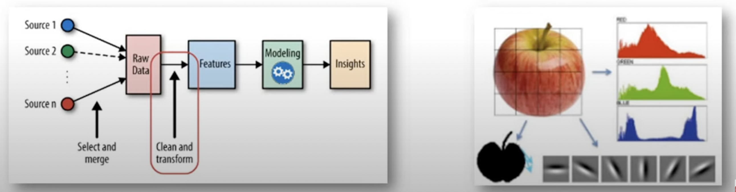
About Features in Data Mining
* Feature engineering refers to the process of using domain knowledge to select and transform the most relevant variables from raw data when creating a predictive model using machine learning or statistical modelling
* The goal of feature engineering and selection is to improve the performance of Data Mining (ML) algorithms.
Notes:
Finding relevant features using domain knowledge
Goal is

Slide 3
Feature Selection
Feature selection technique finds a smaller subset of many dimensioanl data set to create data model
It is a technique of finding k feature of the d diemnsions that gives us the most information and discard the other (d-k) diemnsions
Filter Selection Methods
Filter Method
Wrapper Method
Embedded Method
Feature Selection
Filter
Wrapper
Embedded

Slide 4
Feature Selection - Wrappers
Exhaustive Search - Exhausting
Forward Search – O(n² · learning/testing time) - Greedy
Score each feature by itself and add the best feature to the initially empty set FS (FS will be our final Feature Set)
Try each subset consisting of the current FS plus one remaining feature and add the best feature to FS
Continue until stop getting significant improvement (over a window)
Backward Search – O(n² · learning/testing time) - Greedy
Score the initial complete FS
Try each subset consisting of the current FS minus one feature in FS and drop the feature from FS causing least decrease in accuracy
Continue until dropping any feature causes a significant decreases in accuracy
Branch and Bound and other heuristic approaches available
Notes:
Forward search could miss important higher order combinations. Backward search more robust to the higher order problem, since acc will drop if we drop an important feature which may have not been selected in forward.
Show a little example of each with values for 4 total features and when it would stop.

Slide 5
Filter Method:
In this method, features are filtered based on general characteristics (some metric such as correlation) of the dataset such correlation with the dependent variable.
It is faster and usually the better approach when the number of features are huge.
Avoids over fitting but sometimes may fail to select best features.
Correlation
Chi-Square Test: Observed & expected count.
Variance Threshold
Information Gain: Find meaningful information & attribute features. (will cover during Decision tree)
Maximum Relevancy Minimum Redundancy (mRmR)
Notes:
Variance Threshold is a simple baseline approach to feature selection. It removes all features whose variance doesn't meet some threshold. By default, it removes all zero-variance features, i.e. features that have the same value in all samples.

Slide 6

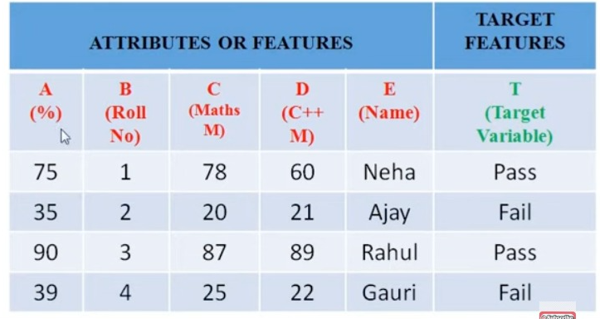
Example

Slide 7
Covariance
Covariance measures the direction of the relationship between two variables.
A positive covariance means that both variables tend to be high or low at the same time.
A negative covariance means that when one variable is high, the other tends to be low

Slide 8
Covariance vs Correlation Coefficient
Covariance measures the direction of a relationship between two variables
Correlation measures the strength of that relationship.
Both correlation and covariance are positive when the variables move in the same direction, and negative when they move in opposite directions.
However, a correlation coefficient must always be $between −1 and +1$, with the extreme values indicating a strong relationship.
Notes:
Covariance indicates the direction of the linear relationship between variables while correlation measures both the strength and direction of the linear relationship between two variables. Correlation is a function of the covariance.

Slide 9
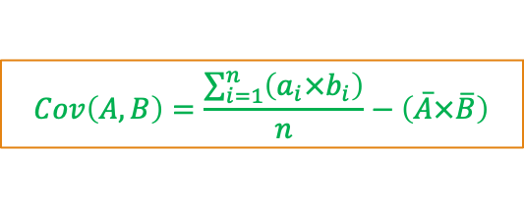
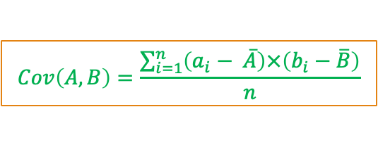
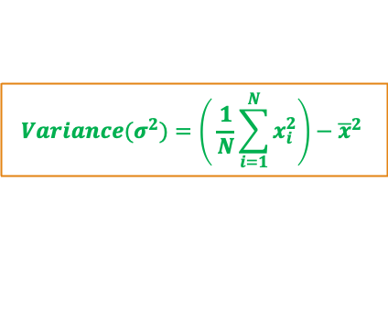
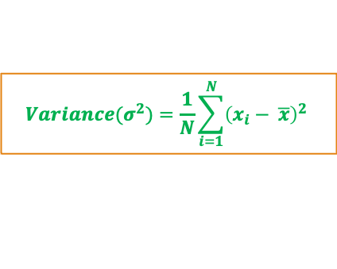
Computing Covariance
Recall from
$$Cov\left(A,B\right)=\frac{\sum_{i=1}^{n}{\left(a_{i}− \overline{A}\right)×\left(b_{i}−\overline{B}\right)}}{n}$$
$${Variance(σ}^{2})=\frac{1}{N}\sum_{i=1}^{N}{{\left(x_{i}− \overline{x}\right)}^{2}}$$
Average of variable A
Average of variable B
$${Variance(σ}^{2})=\left( \frac{1}{N}\sum_{i=1}^{N}{x_{i}^{2}}\right)−{\overline{x}}^{2}$$
$$Cov\left(A,B\right)=\frac{\sum_{i=1}^{n}{\left(a_{i}×b_{i}\right)}}{n}−\left(\overline{A}×\overline{B}\right)$$
Note: Variance is special case of covariance where two attributes are identical (covariance with itself)

Slide 10
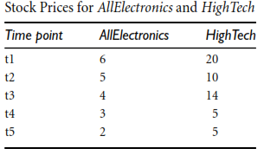
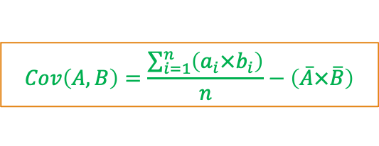
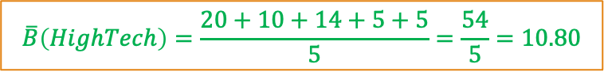
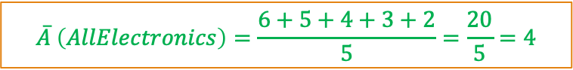
Computing Covariance
$$Cov\left(A,B\right)=\frac{\sum_{i=1}^{n}{\left(a_{i}×b_{i}\right)}}{n}−\left(\overline{A}×\overline{B}\right)$$
$$\overline{A} \left(AllElectronics\right)=\frac{6+5+4+3+2}{5}=\frac{20}{5}=4$$
$$\overline{B}\left(HighTech\right)=\frac{20+10+14+5+5}{5}=\frac{54}{5}=10.80$$
$$Cov\left(AllElectronics, HighTech\right)=\frac{6×20+5×10+4×14+3×5+2×5}{5}−4×10.80$$
$$Cov\left(AllElectronics, HighTech\right)=50.2−43.2$$
$$Cov\left(AllElectronics, HighTech\right)=7$$
What if the data is nominal?

Slide 11
Correlation
Correlation is a statistical term describing the degree to which two variables move in coordination with one another.
If the two variables move in the same direction, then those variables are said to have a positive correlation.
If they move in opposite directions, then they have a negative correlation.
The strength of the correlation is determined by the correlation coefficient, which varies between $−1$ and $+1$.
What if correlation is 0?
Notes:
A correlation coefficient of zero indicates that no linear relationship exists between two continuous variables, and a correlation coefficient of −1 or +1 indicates a perfect linear relationship.

Slide 12
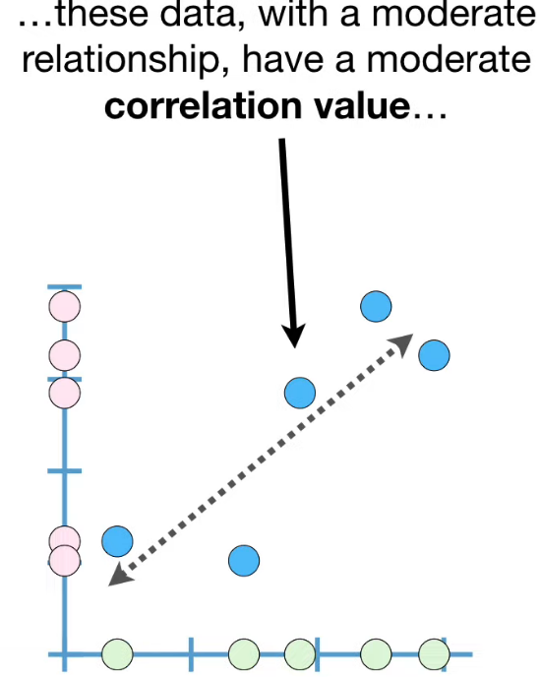
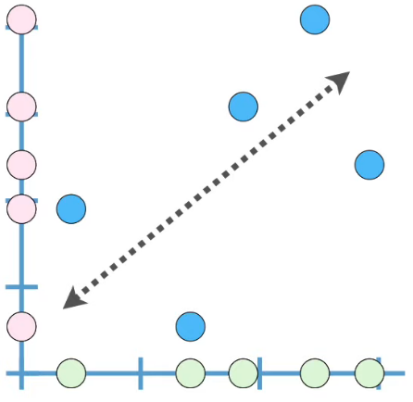
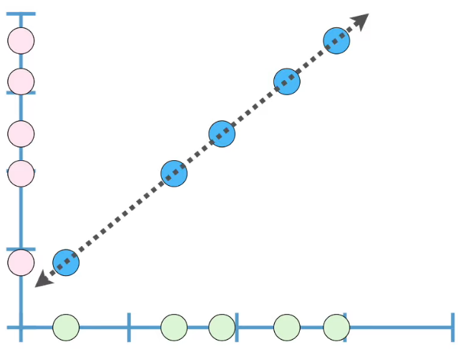
Correlation Between Two Variables
Correlation is 1 if a straight line with positive slope can be drawn from the center of all data points
Weak relationship have small correlation value…
Strong relationship have large correlation value…

Slide 13
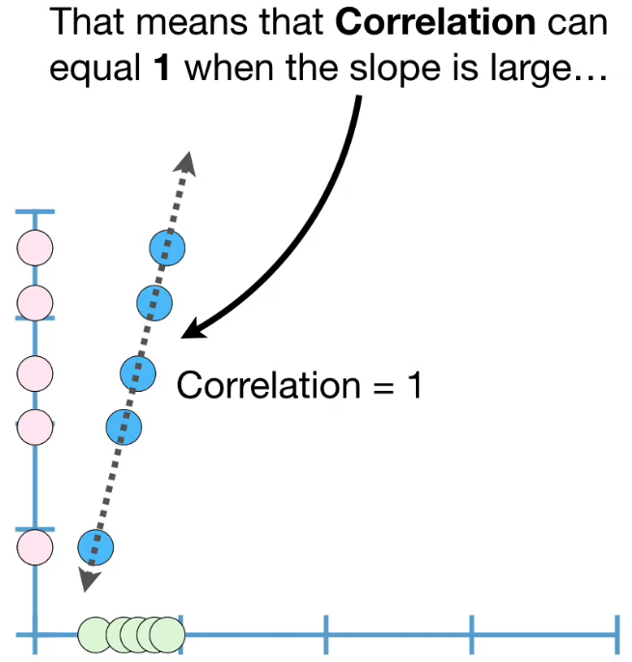
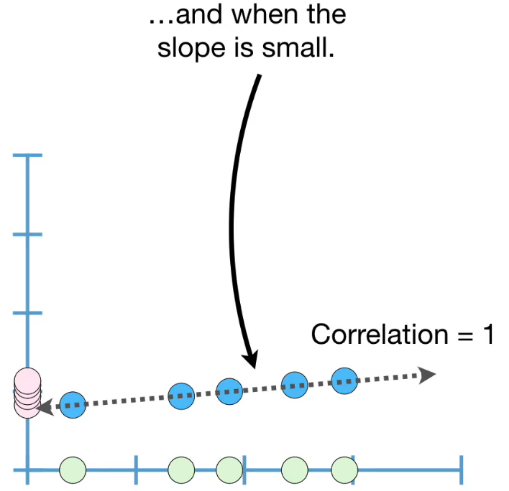
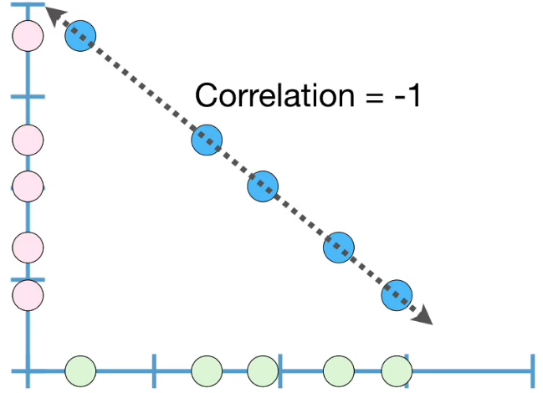
Correlation Between Two Variables

Slide 14
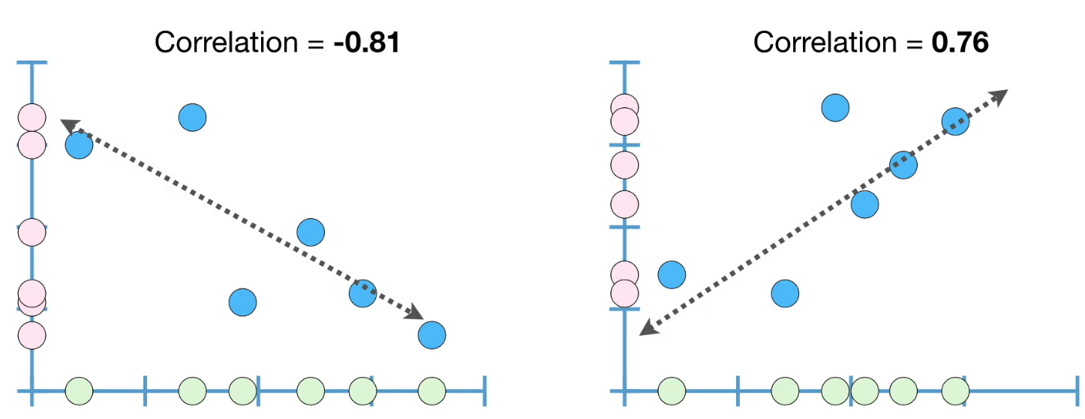
Correlation Between Two Variables

Slide 15
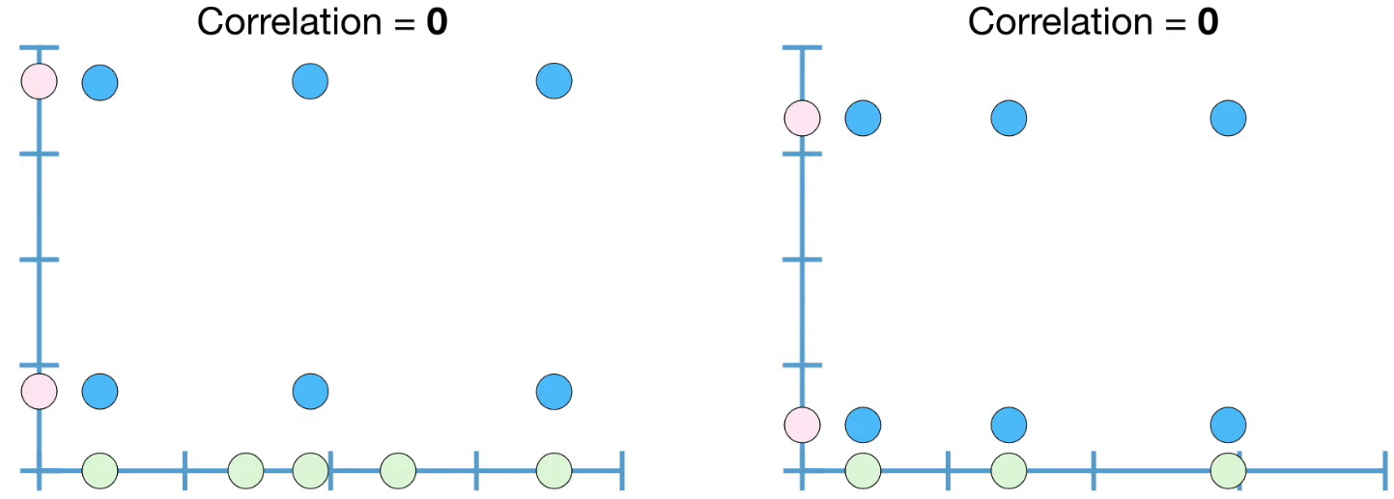
Correlation Between Two Variables
But … How to Compute Correlation?

Slide 16
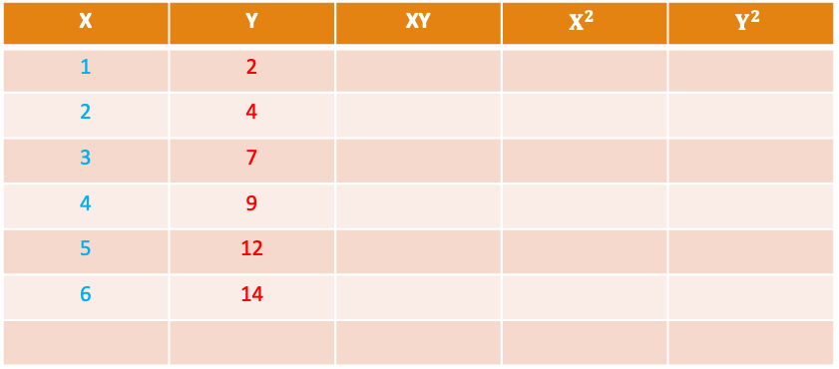
Computing Correlation
X | Y
1 | 2
2 | 4
3 | 7
4 | 9
5 | 12
6 | 14
X | Y | XY | $$X^{2}$$ | $$Y^{2}$$
1 | 2
2 | 4
3 | 7
4 | 9
5 | 12
6 | 14

Slide 17
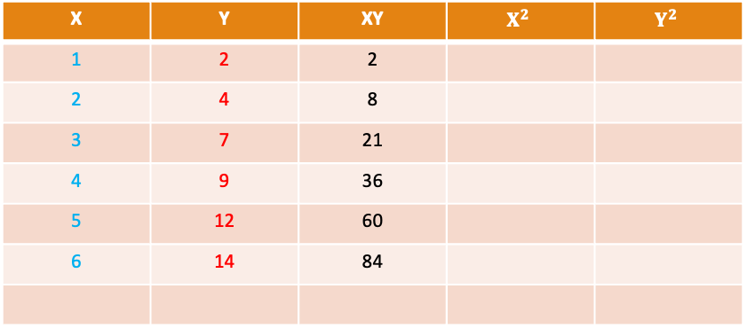
Computing Correlation
X | Y
1 | 2
2 | 4
3 | 7
4 | 9
5 | 12
6 | 14
X | Y | XY | $$X^{2}$$ | $$Y^{2}$$
1 | 2 | 2
2 | 4 | 8
3 | 7 | 21
4 | 9 | 36
5 | 12 | 60
6 | 14 | 84

Slide 18
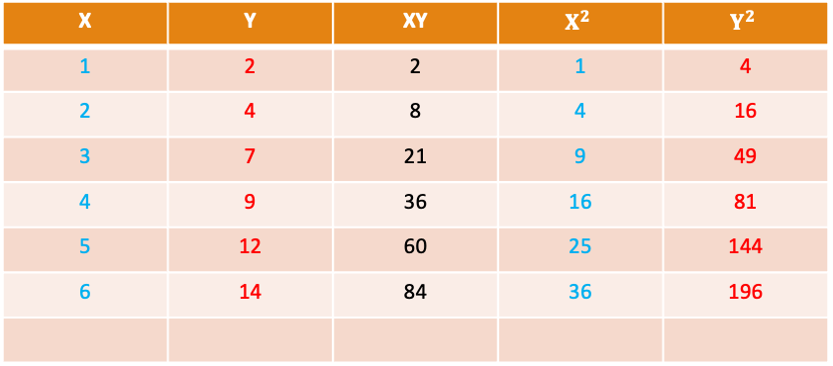
Computing Correlation
X | Y
1 | 2
2 | 4
3 | 7
4 | 9
5 | 12
6 | 14
X | Y | XY | $$X^{2}$$ | $$Y^{2}$$
1 | 2 | 2 | 1 | 4
2 | 4 | 8 | 4 | 16
3 | 7 | 21 | 9 | 49
4 | 9 | 36 | 16 | 81
5 | 12 | 60 | 25 | 144
6 | 14 | 84 | 36 | 196
21
48
211
91
490
$$\sum{X}$$
$$\sum{Y}$$
$$\sum{XY}$$
$$\sum{X^{2}}$$
$$\sum{Y^{2}}$$

Slide 19
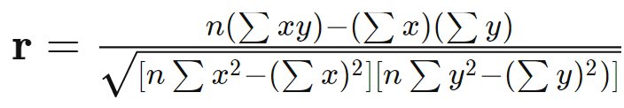
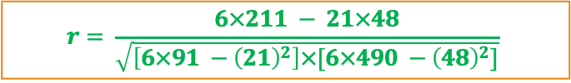
Computing Correlation
X | Y
1 | 2
2 | 4
3 | 7
4 | 9
5 | 12
6 | 14
$$r= \frac{6×211 − 21×48}{\sqrt{\left[6×91 −{\left(21\right)}^{2}\right]×[6×490 −{\left(48\right)}^{2}]}}$$
$$r= \frac{1266−1008}{\sqrt{\left[546−441\right]×[2940 −2304]}}=\frac{258}{\sqrt{105×636 }}=\frac{258}{\sqrt{66780}}=0.998$$
21
48
211
91
490
This is “Pearson’s Correlation Coefficient”
$$\sum{X}$$
$$\sum{Y}$$
$$\sum{XY}$$
$$\sum{X^{2}}$$
$$\sum{Y^{2}}$$
More Details: https://www.investopedia.com/ask/answers/032515/what-does-it-mean-if-correlation-coefficient-positive-negative-or-zero.asp

Slide 20
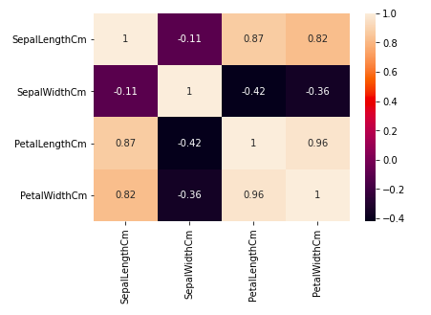
Correlation of Multiple Variables
IRIS Dataset: Again…
Heatmap
Notes:
Petal width and petal length have high correlations.
Petal length and sepal width have good correlations.
Petal Width and Sepal length have good correlations.

Slide 21
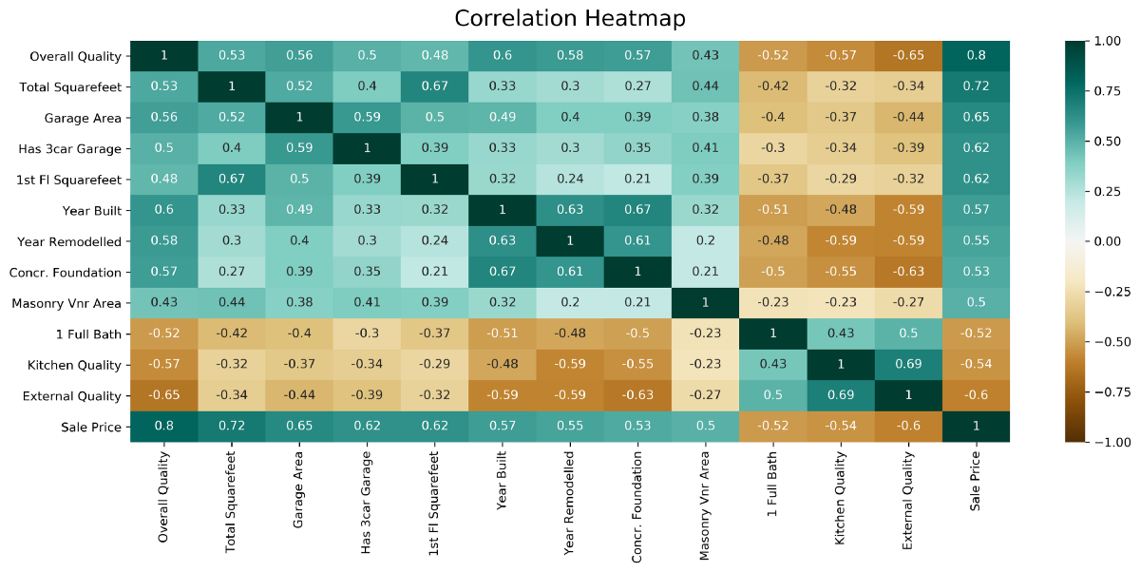
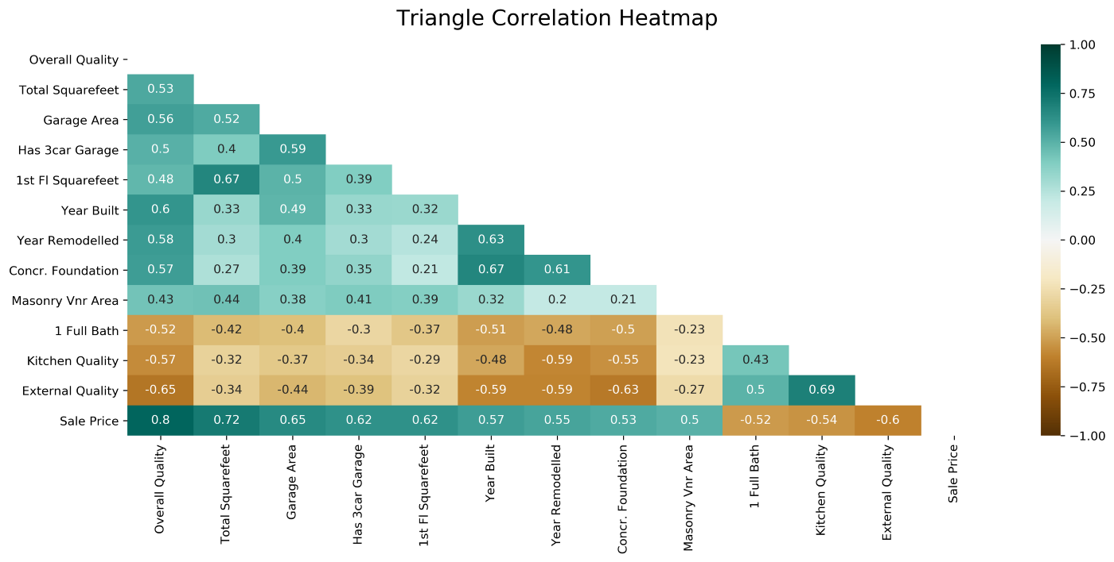
Correlation Heatmaps: Complex Examples
We can also create heatmaps for Similarity and Dissimilarity (Distance) between two objects/records…
But … What is similarity and dissimilarity between two objects and how to measure it?

Slide 22
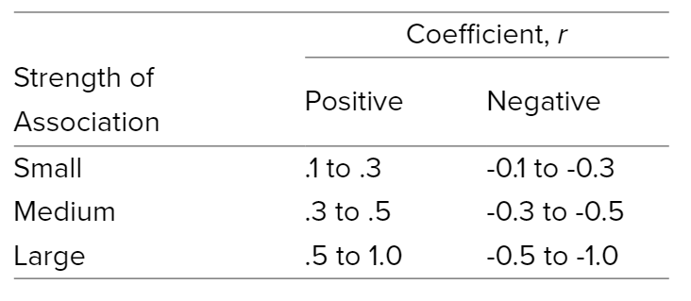
Correlation Interpretation
More Details: https://statistics.laerd.com/statistical-guides/pearson-correlation-coefficient-statistical-guide.php

Slide 23
Correlation does NOT imply causality…
if A and B are correlated, this does not necessarily imply that A causes B or that B causes A.
For example, in analyzing a demographic database, we may ﬁnd that attributes representing the number of hospitals and the number of car thefts in a region are correlated.
This does not mean that one causes the other.
Both are actually causally linked to a third attribute, namely, population.

Slide 24
What Correlation Tells Us?
Some attributes are redundant
Redundancy here means that an attribute (such as annual_revenue) may be redundant if it can be “derived” from other attribute or set of attributes.
Inconsistencies in attribute (or dimension) naming can also cause redundancies in the resulting dataset.
Some redundancies can be detected by correlation analysis.

Slide 25
Covariance vs Correlation
Covariance : Direction (any value)
Correlation: Direction and Strength (-1 to +1)

Slide 26
Correlation Analysis
Correlation Analysis:
Given two attributes, how strongly one attribute implies the other, based on the available data
For Numerical Data:
Correlation coefficient (or Pearson’s Correlation Coefficient)
Covariance
For Nominal Data:
$χ^{2}$ (Chi-Square) test

Slide 27
Activity
Calculate Correlation between these two variables X, Y
X | Y
2 | 10
4 | 9
6 | 8
8 | 7
10 | 6

Slide 28
Activity
Calculate Covariance of the following two variables X, Y
X | Y
2.1 | 8
2.5 | 10
3.6 | 12
4 | 14
Notes:
Cov(X,Y)≈2.27

Slide 29
$χ^{2}$Correlation for Nominal Data
Suppose that a group of 1500 people was surveyed.
The gender of each person was noted. Each person was polled as to whether his or her preferred type of reading material was ﬁction or nonﬁction.
Thus, we have two attributes, gender and preferred reading.
The observed frequency (or count) of each possible joint event is summarized in the contingency table

Slide 30
$χ^{2}$Correlation for Nominal Data
 | male | female | Total
fiction
non-fiction
Total

Slide 31

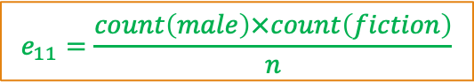
$χ^{2}$Correlation for Nominal Data
 | male | female | Total
fiction | 250 | 200 | 450
non-fiction | 50 | 1000 | 1050
Total | 300 | 1200 | 1500
1- Find expected values for this contingency Table
$$e_{11}=\frac{count\left(male\right)×count\left(fiction\right)}{n}$$
$$e_{11}=\frac{300×450}{1500}=90$$
 | male | female
fiction | 90
non-fiction
Notes:
e(mf) = 90 e(mn) = 210 e(ff) = 360 e(fn) = 840

Slide 32
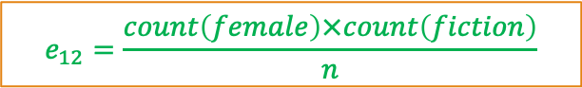

$χ^{2}$Correlation for Nominal Data
 | male | female | Total
fiction | 250 | 200 | 450
non-fiction | 50 | 1000 | 1050
Total | 300 | 1200 | 1500
1- Find expected values for this contingency Table
$$e_{12}=\frac{count\left(female\right)×count\left(fiction\right)}{n}$$
$$e_{12}=\frac{1200×450}{1500}=360$$
 | male | female
fiction | 90 | 360
non-fiction

Slide 33
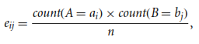
$χ^{2}$Correlation for Nominal Data
 | male | female | Total
fiction | 250 | 200 | 450
non-fiction | 50 | 1000 | 1050
Total | 300 | 1200 | 1500
1- Find expected values for this contingency Table
$$e_{12}=\frac{count\left(female\right)×count\left(fiction\right)}{n}$$
$$e_{12}=\frac{1200×450}{1500}=360$$
 | male | female
fiction | 90 | 360
non-fiction | 210 | 840

Slide 34

$χ^{2}$Correlation for Nominal Data
 | male | female | Total
fiction | 250 | 200 | 450
non-fiction | 50 | 1000 | 1050
Total | 300 | 1200 | 1500
 | male | female
fiction | 90 | 360
non-fiction | 210 | 840
2- Compute $χ^{2}$
$$χ^{2}=\frac{{\left(250−90\right)}^{2}}{90}+\frac{{\left(50−210\right)}^{2}}{210}+\frac{{\left(200−360\right)}^{2}}{360}+\frac{{\left(1000−840\right)}^{2}}{840}$$
$$χ^{2}=284.44+121.90+71.11+30.48=507.93$$

Slide 35
$χ^{2}$Correlation for Nominal Data
 | male | female | Total
fiction | 250 (90) | 200 (360) | 450
non-fiction | 50 (210) | 1000 (840) | 1050
Total | 300 | 1200 | 1500
2- Compute $χ^{2}$
$$χ^{2}=\frac{{\left(250−90\right)}^{2}}{90}+\frac{{\left(50−210\right)}^{2}}{210}+\frac{{\left(200−360\right)}^{2}}{360}+\frac{{\left(1000−840\right)}^{2}}{840}$$
$$χ^{2}=284.44+121.90+71.11+30.48=507.93$$

Slide 36
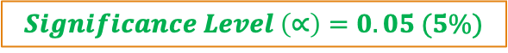

$χ^{2}$Analysis
The larger the $χ^{2}$ value, the more likely the variables are related
The cells that contribute the most to the $χ^{2}$ value are those whose actual count is very different from the expected count
Remember: Correlation does not imply causality
Null Hypothesis: There is no relation between “gender” and “preferred reading ”
Alternate Hypothesis: There is significant relation between “gender” and “preferred reading ”
$$χ^{2}=507.93$$
$$Significance Level \left(∝\right)=0.05 (5\%)$$
$$Degree of Freedom=\left(columns−1\right)×\left(rows−1\right)=(2−1)×(2−1)=1$$

Slide 37
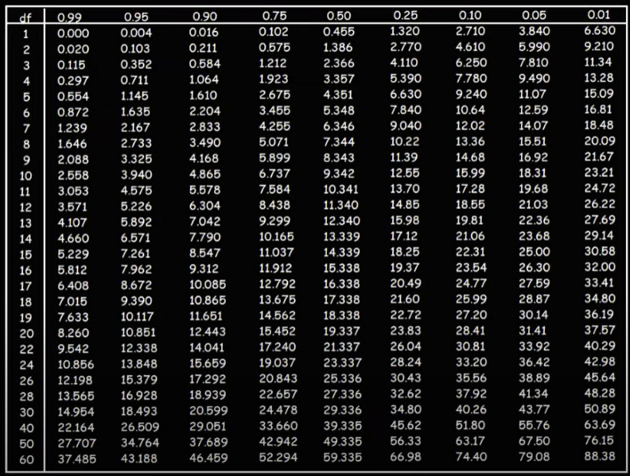
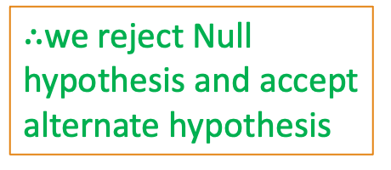

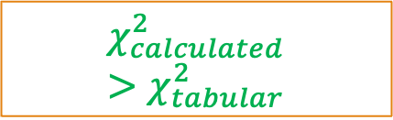
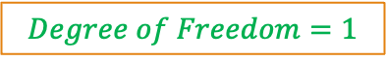
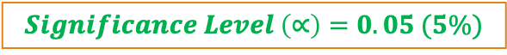
$χ^{2}$Analysis
$$Significance Level \left(∝\right)=0.05 (5\%)$$
$$χ^{2}=507.93$$
$$Degree of Freedom=1$$
$$χ_{calculated}^{2}>χ_{tabular}^{2}$$
$∴$we reject Null hypothesis and accept alternate hypothesis

Slide 38
$χ^{2}$Analysis
Since our computed value is above the tabular value, we can reject the hypothesis that “gender” and “preferred reading ” are independent and conclude that the two attributes are (strongly) correlated for the given group of people.
Significance level can be changed but normally it is 5%

Slide 39
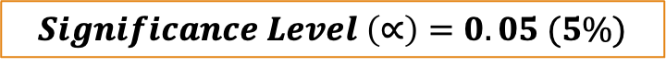
Chi-Square ${(χ}^{2})$: Example 2
Qualification/Marital Status | Middle School | High School | BS | MS | PhD | Total
Never Married | 18 | 36 | 21 | 9 | 6 | 90
Married | 12 | 36 | 45 | 36 | 21 | 150
Divorced | 6 | 9 | 9 | 3 | 3 | 30
Widowed | 3 | 9 | 9 | 6 | 3 | 30
Total | 39 | 90 | 84 | 54 | 33 | 300
Observed Values
Null Hypothesis: There is no relation between “marital status” and “qualification”
Alternate Hypothesis: There is significant relation between “marital status” and “qualification”
$$Significance Level \left(∝\right)=0.05 (5\%)$$
Credit: Vectors Academy

Slide 40
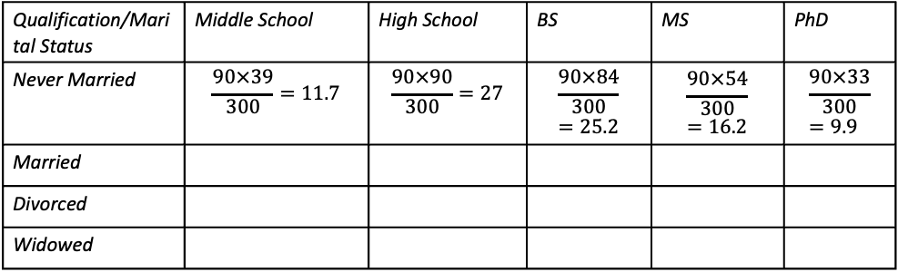
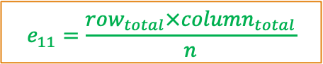
Chi-Square ${(χ}^{2})$: Example 2
$$e_{11}=\frac{row_{total}×column_{total}}{n}$$
Qualification/Marital Status | Middle School | High School | BS | MS | PhD | Total
Never Married | 18 | 36 | 21 | 9 | 6 | 90
Married | 12 | 36 | 45 | 36 | 21 | 150
Divorced | 6 | 9 | 9 | 3 | 3 | 30
Widowed | 3 | 9 | 9 | 6 | 3 | 30
Total | 39 | 90 | 84 | 54 | 33 | 300
Observed Values
Qualification/Marital Status | Middle School | High School | BS | MS | PhD
Never Married | $$\frac{90×39}{300}=11.7$$ | $$\frac{90×90}{300}=27$$ | $$\frac{90×84}{300}=25.2$$ | $$\frac{90×54}{300}=16.2$$ | $$\frac{90×33}{300}=9.9$$
Married
Divorced
Widowed
Expected Values
Credit: Vectors Academy

Slide 41
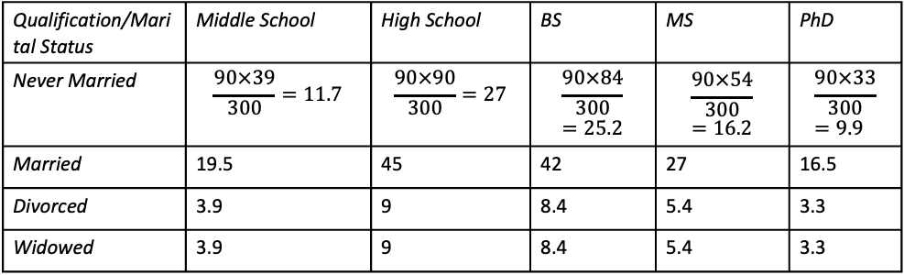
Chi-Square ${(χ}^{2})$: Example 2
$$e_{11}=\frac{row_{total}×column_{total}}{n}$$
Qualification/Marital Status | Middle School | High School | BS | MS | PhD | Total
Never Married | 18 | 36 | 21 | 9 | 6 | 90
Married | 12 | 36 | 45 | 36 | 21 | 150
Divorced | 6 | 9 | 9 | 3 | 3 | 30
Widowed | 3 | 9 | 9 | 6 | 3 | 30
Total | 39 | 90 | 84 | 54 | 33 | 300
Observed Values
Qualification/Marital Status | Middle School | High School | BS | MS | PhD
Never Married | $$\frac{90×39}{300}=11.7$$ | $$\frac{90×90}{300}=27$$ | $$\frac{90×84}{300}=25.2$$ | $$\frac{90×54}{300}=16.2$$ | $$\frac{90×33}{300}=9.9$$
Married | 19.5 | 45 | 42 | 27 | 16.5
Divorced | 3.9 | 9 | 8.4 | 5.4 | 3.3
Widowed | 3.9 | 9 | 8.4 | 5.4 | 3.3
Expected Values
Credit: Vectors Academy

Slide 42
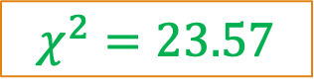
Chi-Square ${(χ}^{2})$: Example 2
$$e_{11}=\frac{row_{total}×column_{total}}{n}$$
Qualification/Marital Status | Middle School | High School | BS | MS | PhD | Total
Never Married | 18 (11.7) | 36 (27) | 21 (25.2) | 9 (16.2) | 6 (9.9) | 90
Married | 12 (19.5) | 36 (45) | 45 (42) | 36 (27) | 21 (16.5) | 150
Divorced | 6 (3.9) | 9 (9) | 9 (8.4) | 3 (5.4) | 3 (3.3) | 30
Widowed | 3 (3.9) | 9 (9) | 9 (8.4) | 6 (5.4) | 3 (3.3) | 30
Total | 39 | 90 | 84 | 54 | 33 | 300
Observed Values
(Expected Values)
$$χ^{2}=23.57$$
$$Degree of Freedom=\left(columns−1\right)×(rows−1)$$
$$Degree of Freedom=\left(5−1\right)×\left(4−1\right)=4×3=12$$
Credit: Vectors Academy

Slide 43
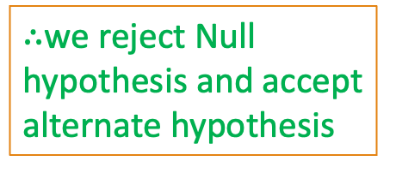
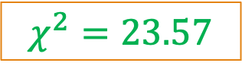


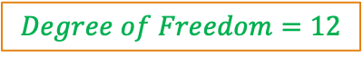
Chi-Square ${(χ}^{2})$: Example 2
$$χ^{2}=23.57$$
$$Degree of Freedom=12$$
$$Significance Level \left(∝\right)=0.05 (5\%)$$
$$χ_{calculated}^{2}>χ_{tabular}^{2}$$
$∴$we reject Null hypothesis and accept alternate hypothesis
Credit: Vectors Academy

Slide 44
Variance Threshold
Variance Threshold is a simple baseline approach to feature selection.
It removes all features whose variance doesn't meet some threshold.
By default, it removes all zero-variance features, i.e. features that have the same value in all samples.

Slide 45
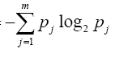
Information Gain
This formula is called Entropy H
H(X) =
High Entropy means that the examples have more equal probability of occurrence

Slide 46
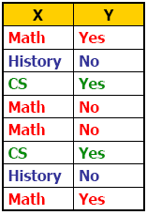
Information Gain
Suppose we are trying to predict output Y (Like Film Gladiator) & we have input X (College Major = v)
Major
Math
CS
History

Slide 47
mRmR (Maximum Relavance and Minimum Redundancy)
It is a powerful technique that helps select the most relevant and non-redundant features from a large pool of potential features.
mRMR is an elegant solution that balances the trade-off between relevance and redundancy.
The method selects features that are highly correlated with the target variable (maximum relevance) but have a low correlation with each other (minimum redundancy).
The subset of top-ranked features is selected as the final feature set for model building.
mRMR is computationally efficient and can handle high-dimensional data with many features

Slide 48
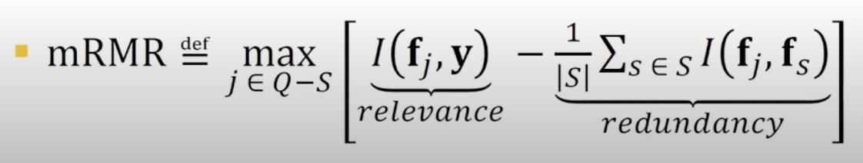
mRmR

Slide 49
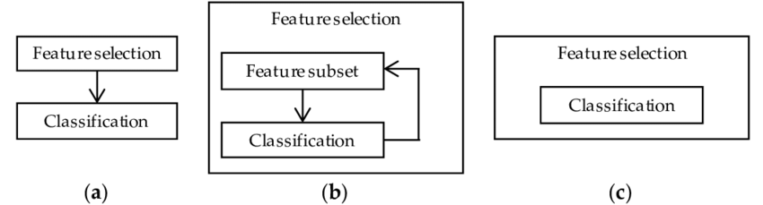
Wrapper Method:
In wrapper method, the feature selection algorithm exits as a wrapper around the predictive model algorithm and uses the same model to select best features
Though computationally expensive and prone to over fitting, gives better performance.

Slide 50
Feature Selection - Filters
Given n original features, how do you select size of subset
User can preselect a size p (< n) – not usually as effective
Usually try to find the smallest size where adding more features does not yield improvement
Filters work independent of any particular learning algorithm
Filters seek a subset of features which maximize some type of between class separability – or other merit score
Can score each feature independently and keep best subset
e.g. 1st order correlation with output, fast, less optimal
Can score subsets of features together
Exponential number of subsets requires a more efficient, sub-optimal search approach
How to score features is independent of the ML model to be trained on and is an important research area
Decision Tree or other ML model pre-process
Notes:
1st order problem (xor example)
segue way into wrappers by asking what is "dumb" alg for best features subset for a "specific alg/task" (highlight the specific alg difference)

Slide 51
Feature Selection - Wrappers
Optimizes for a specific learning algorithm
The feature subset selection algorithm is a "wrapper" around the learning algorithm
Pick a feature subset and pass it to learning algorithm
Create training/test set based on the feature subset
Train the learning algorithm with the training set
Find accuracy (objective) with validation set
Repeat for all feature subsets and pick the feature subset which gives the highest predictive accuracy (or other objective)
Basic approach is simple
Variations are based on how to select the feature subsets, since there are an exponential number of subsets
Notes:
You may use – know this one well

Slide 52
Example
M1= A+B
M2=A+C+D
M3= A+E
M4 = B+E

Slide 53
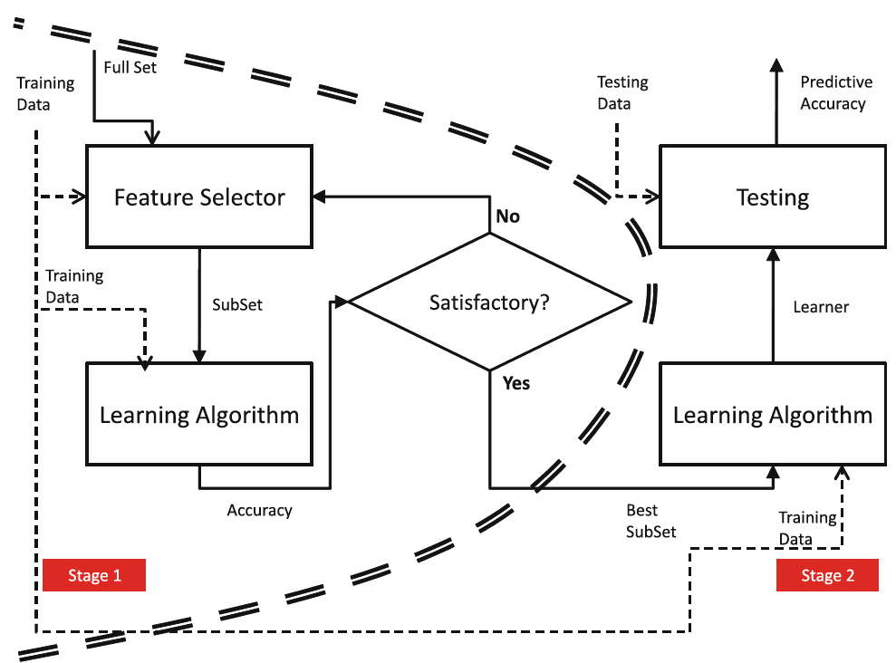
Wrapper Method

Slide 54
Embedded Method
Embedded methods combine the qualities of filter and wrapper methods.
It's implemented by algorithms that have their own feature selection methods in them. eg. Decision Tree
Advantages of Embedded Methods:
They take into consideration the interaction of features like wrapper methods do.
They are faster like filter methods.
They are more accurate than filter methods.
They find the feature subset for the algorithm being trained.
They are much less prone to over-fitting.

Slide 55
Feature Subset Selection
FILTER WRAPPER EMBEDDED

Slide 56
Benefits of Feature Selection Methods
Reduces Overfitting: Less redundant data means less opportunity to make decisions based on noise.
Improves Accuracy: Less misleading data means modelling accuracy improves.
Reduces Training Time: fewer data points reduce algorithm complexity and algorithms train faster:
Data Mining Algorithm
Actual Feature Set
Subset of Features
Model Performance Evaluation

Slide 57
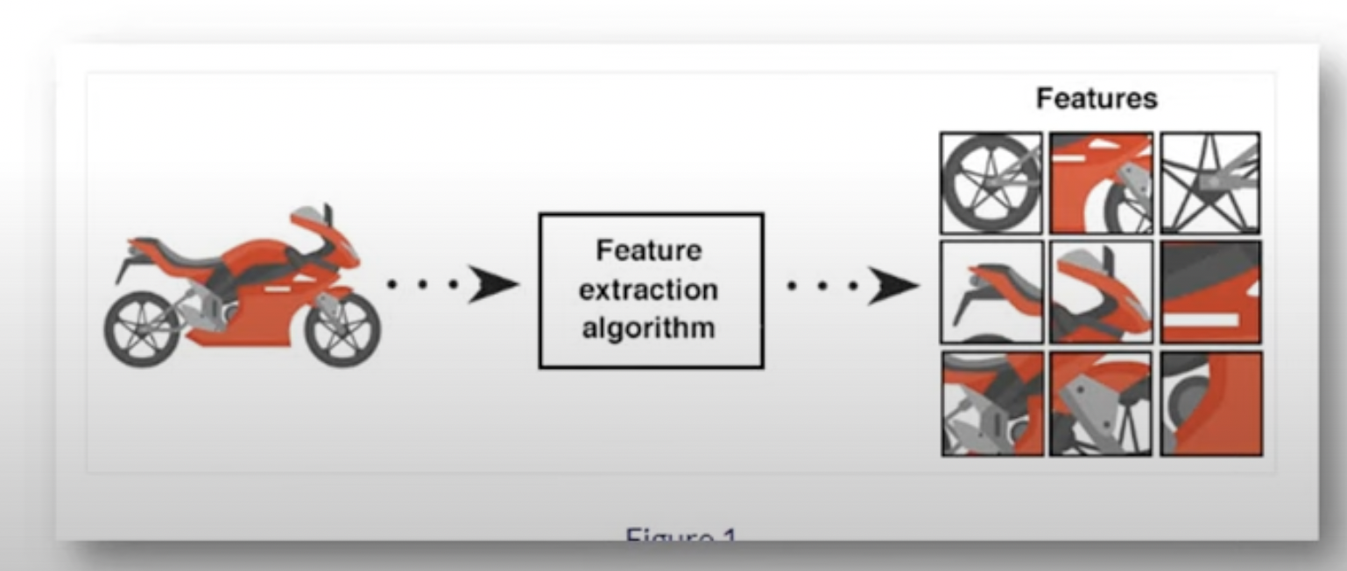
Feature Extraction
Feature extraction involves transforming high dimensional data into space of fewer dimensional.
* Features extraction is a technique of finding a new set of k dimensions that are combinations of original d dimensions.
* The best known & most widely used feature extraction method is Principle Component
Analysis (PCA).

